Slide 1
Long Short Term Convolutional Neural Network Classifier to Diagnosis Alzheimer’s Disease
William Floyd Jones

Slide 2
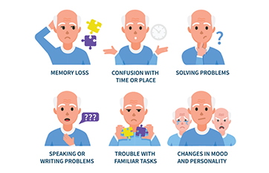
What is Alzheimer's?
Alzheimer's is a disease that is a form of dementia.
Affects cognitive abilities and worsens over time.
Makes up about 60-80% of dementia cases.
Mostly in older adults
There is no cure
Image from: https://practicalneurology.com/patients-caregivers/alzheimers-dementia

Slide 3
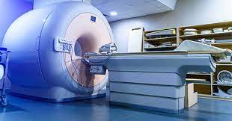
Alzheimer detection
Some ways to assess for alzheimer's is mental status testing, interviews with family, and brain imaging(MRI, CT, PET).
What if we could detect signs of alzheimer's faster with Artificial Intelligence in MRIs?
Image taken from: https://www.hss.edu/condition-list_mri-magnetic-resonance-imaging.asp

Slide 4
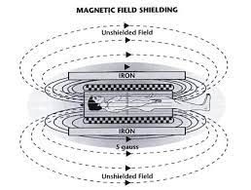
What is a MRI
Mri stands for Magnetic Resonance Imaging
Noninvasive
Magnets realign water molecules in the body and the radio waves cause the atoms to produce signals that in turn become images.
Image taken from: http://www.sprawls.org/mripmt/MRI02/index.html

Slide 5
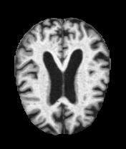
Data Collection
Data was taken from a kaggle dataset: https://www.kaggle.com/datasets/tourist55/alzheimers-dataset-4-class-of-images
Data is broken into two files of test and train with each having a categories : Mild Demented, Moderate Demented, Non Demented, and Very Mild Demented.
 | Test set of images | Train set of images
Mild | 179 | 717
Moderate | 12 | 52
Non | 640 | 2560
Very Mild | 448 | 1792

Slide 6
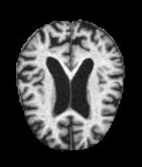
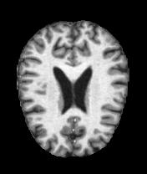
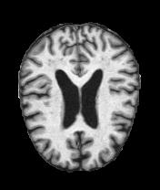
Images in Data Set
Mild
Moderate
NonDemented
Very Mild

Slide 7
What is a LSTM and CNN?
LSTM
LSTM stands for Long Short Term Memory
Help prevent overtraining
CNN
CNN stands for Convolution
Types of layers: Convolutional, Fully Connected, Pooling, Dropout, and Activation.
Best used for images
Feed forward network

Slide 8
Methodology
Resize images and break train data into train and validation data for model
Build a CNN and LSTM-CNN model
Fit each model to training data with validation data
Produce metrics of Accuracy, Area Under Curve, Loss, F1 Score, and Precision
Compare each model in plots
Evaluate each model on test

Slide 9
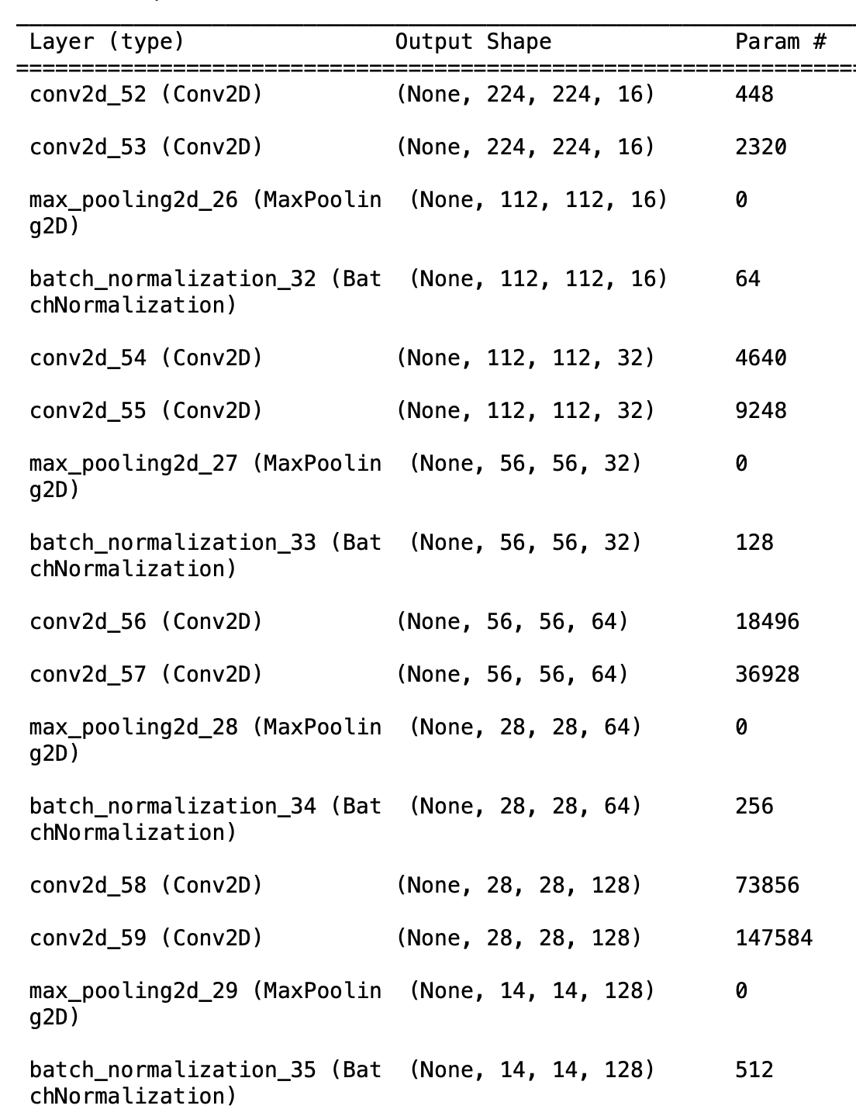
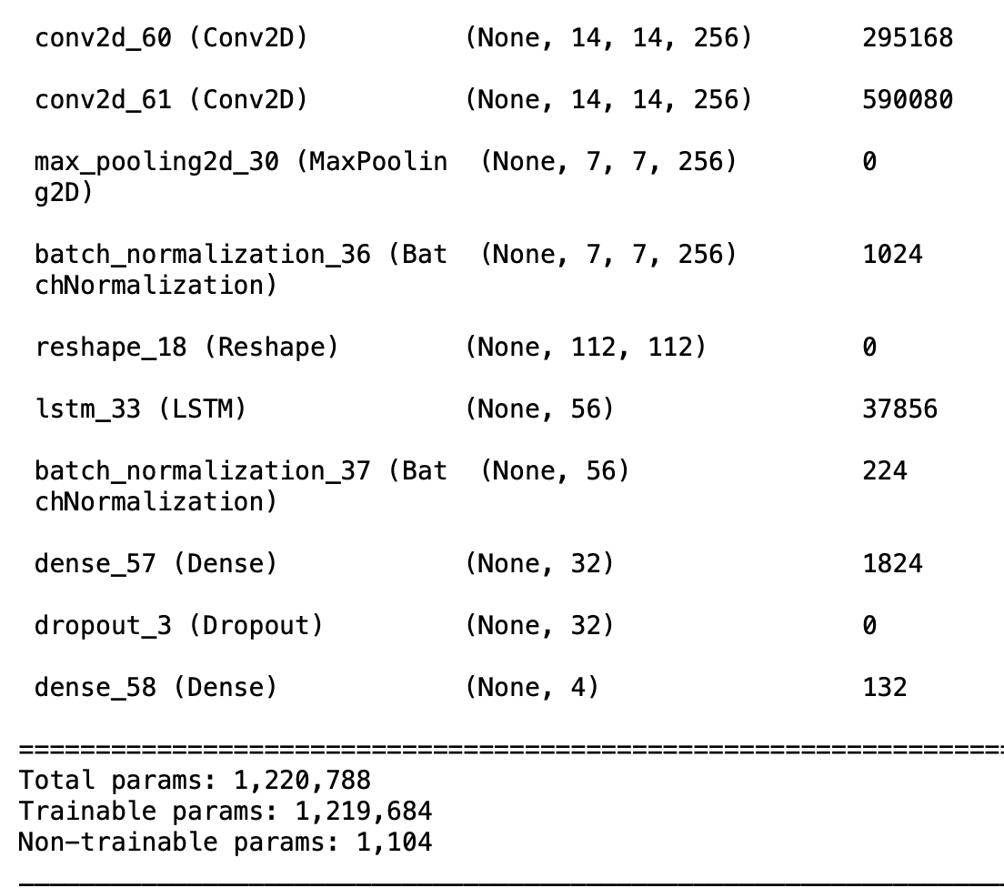
LSTM-CNN model

Slide 10
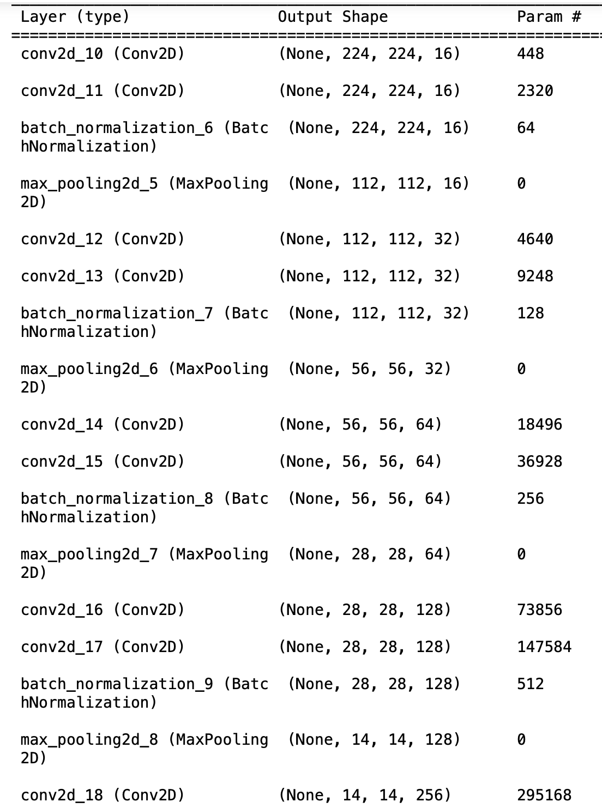
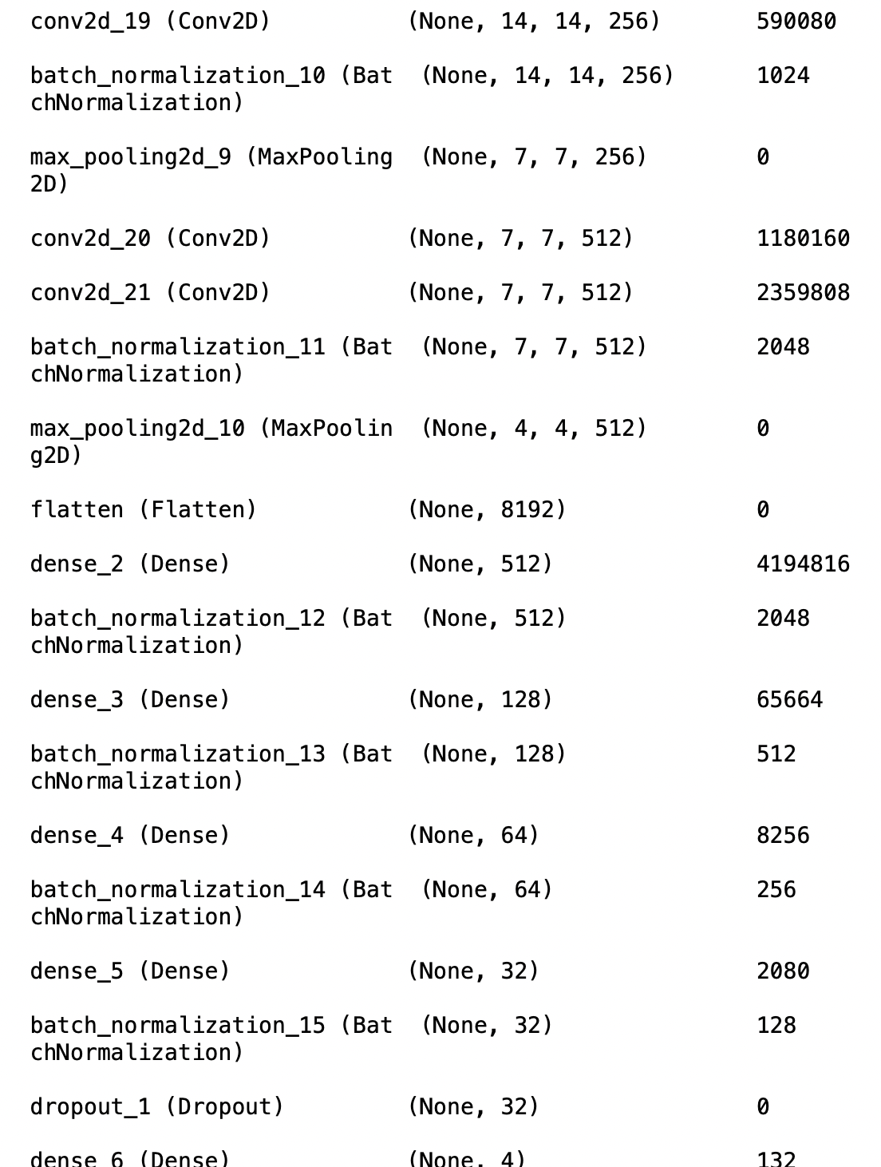
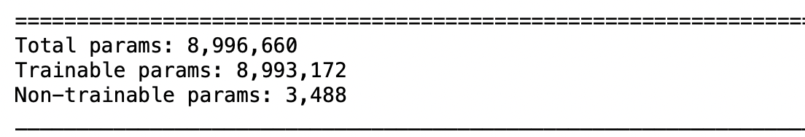
CNN model

Slide 11
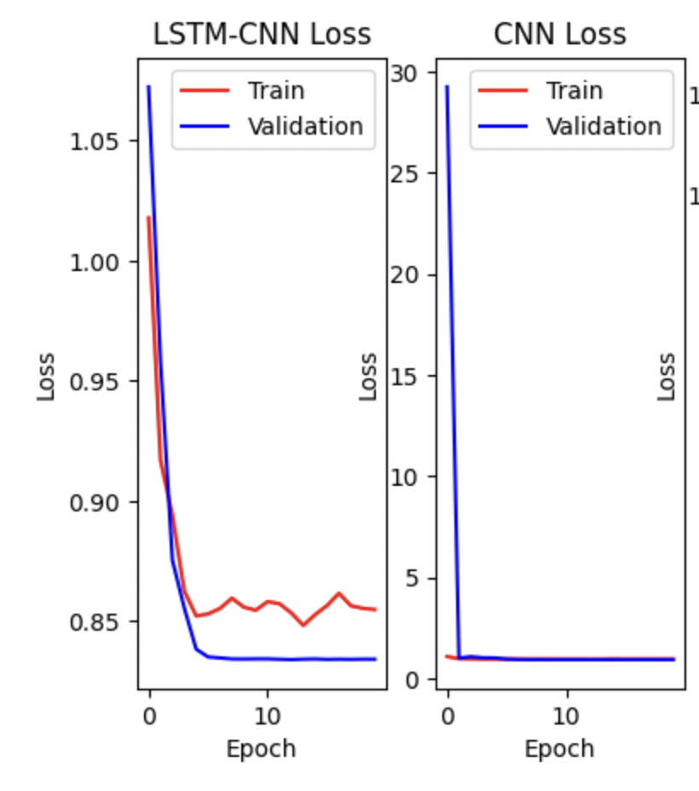
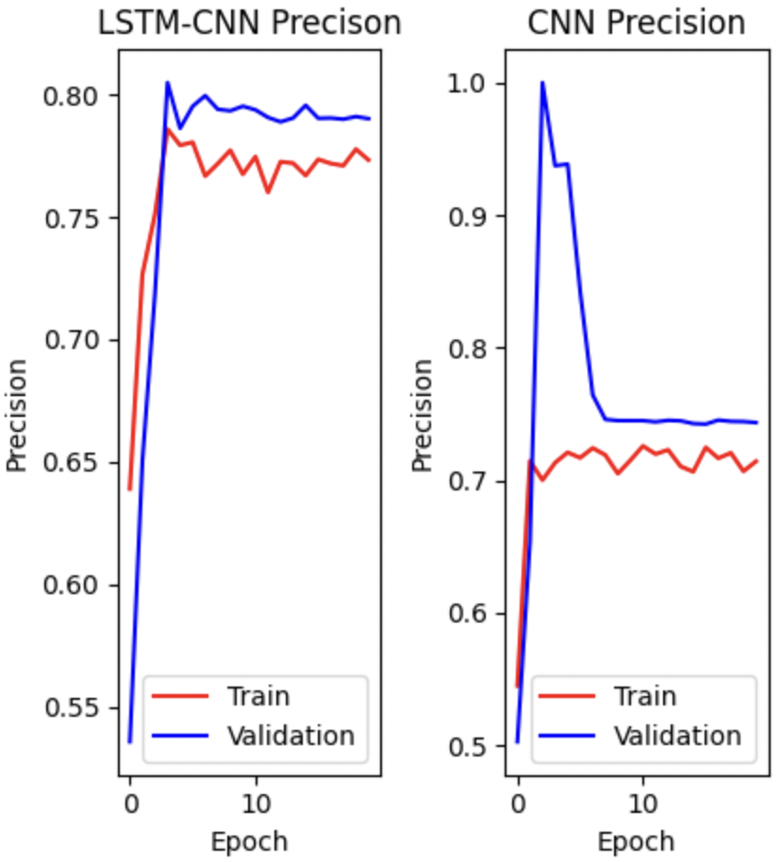
Results

Slide 12
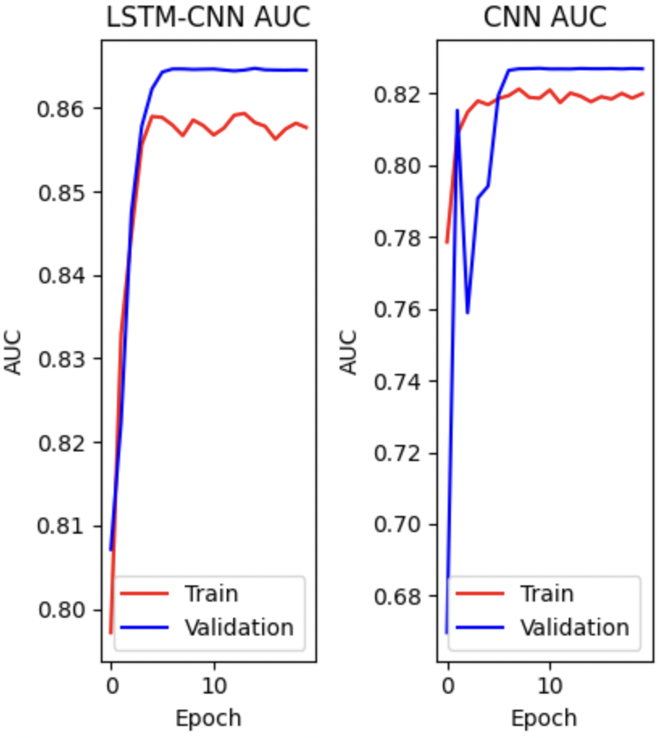
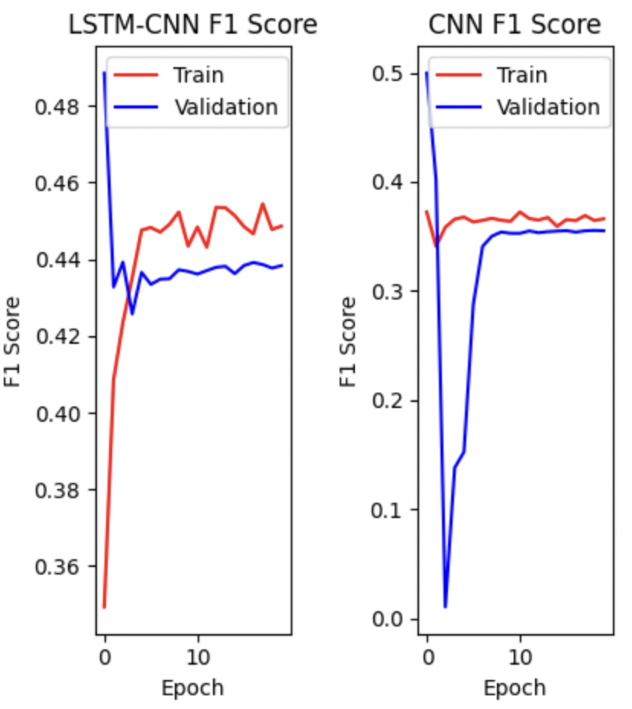
Results Continued

Slide 13
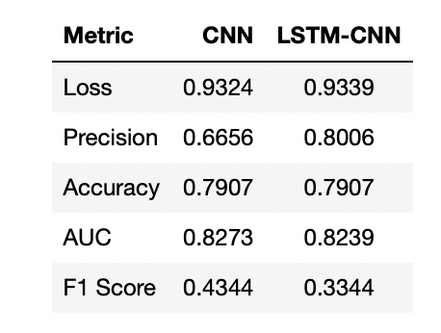
Models against Test class

